Slide 1
Engaging Afterschool Programs to Support College and Career Readiness
Susan Stanton, ACT Now Network Lead
Shallie Pittman, ACT Now Youth Development Associate

Slide 2
Welcome
Susan Stanton, Network Lead
Shallie Pittman, Youth Development Associate

Slide 3
Agenda
Background on ACT Now
Importance of College Preparedness in Afterschool
Strategies for Fostering College Preparedness in Afterschool
Building Partnerships
Quality in Afterschool

Slide 4
What is ACT Now?
A statewide coalition that advocates for quality and affordable afterschool programs for Illinois’ youth
Our partners are:
  Providers
  Educators
  State agency members
  Community advocates
  Youth organizations
  Policymakers

Slide 5
What is ACT Now?
ACT Now is a resource for:
  Learning about policy
  Networking with other providers
  Receiving advocacy training
  Learning about strategies for improving quality in afterschool programs
  Drawing on technical expertise to inform best practices
  Connecting with experts on professional development
  Learning about professional development opportunities

Slide 6
ACT Now’s Committees
Policy and Advocacy Committee
Provides a forum for ACT Now’s public and private partners to develop and pursue a shared policy agenda to increase the quality and availability of afterschool programs
Professional Development Committee
Facilitates information sharing and resource coordination to identify and meet the needs of the afterschool field
Quality Assurance, Outcomes, and Evaluation Committee
Promotes the adoption of a common system of Quality Standards statewide and the development of capacity-building, assessment, and evaluation tools, including those linked to Standards
Working on planning regional meetings and policy trainings along with developing trainings for our Quality Standards

Slide 7
Importance of College Preparedness for Low Income Students
The unemployment rate for individuals with at least a bachelor’s degree is consistently about half the rate for high school graduates
The percentage of jobs that will require some form of postsecondary education will reach a projected 63% by 2018 (up from 28% in the 1970s)
Students not only need higher levels of education– they also need 21st Century skills that are not always taught in the classroom. Higher income students can more easily access opportunities to acquire these skills.
High-achieving students from low-income families are five times less likely to attend college than high-achieving students from high-income families.

Slide 8
Afterschool as the Solution
Afterschool programs can help fill the gaps some low income and minority students face in gaining the skills and finding the resources necessary to enter college
  Provide college application resources
  Learning about careers
  Opportunities to apply academic knowledge
  Opportunities to build skills not always offered in school (work in teams or design and execute complex projects)
  Provide inspiration and motivation to pursue college and careers
Need to start young!

Slide 9
Afterschool as the Solution
Alumni of Citizen Schools’ 8th Grade Academy graduate on time from high school and enroll in 2 and 4 year colleges at approximately double the rate of their peers.
At Project Exploration in Chicago, 95% of participants and alumni have graduated high school or are on track to graduate, nearly double the overall rate of Chicago Public Schools. 60% of students enrolled in a four-year college are pursuing degrees in STEM-related fields.
94% of Gary Comer Youth Center’s 2012 seniors graduated and enrolled in college.
99.3% of Teen REACH seniors graduate

Slide 10
College Preparedness Strategies for Afterschool Programs
Help youth explore, set goals, and prepare for post secondary education
Create partnerships with employers
Develop engaging programming for youth that connects academic work with hands on projects
Opportunities to develop 21st Century skills
Expose youth to subjects they might not get to explore in school, i.e. public interest or STEM careers
Provide resources to help navigate the college application and navigation process
College visits

Slide 11
Building Partnerships
Universities and Colleges
Employers
Schools
Community Groups
Families
Coaches
Churches
Mentors

Slide 12
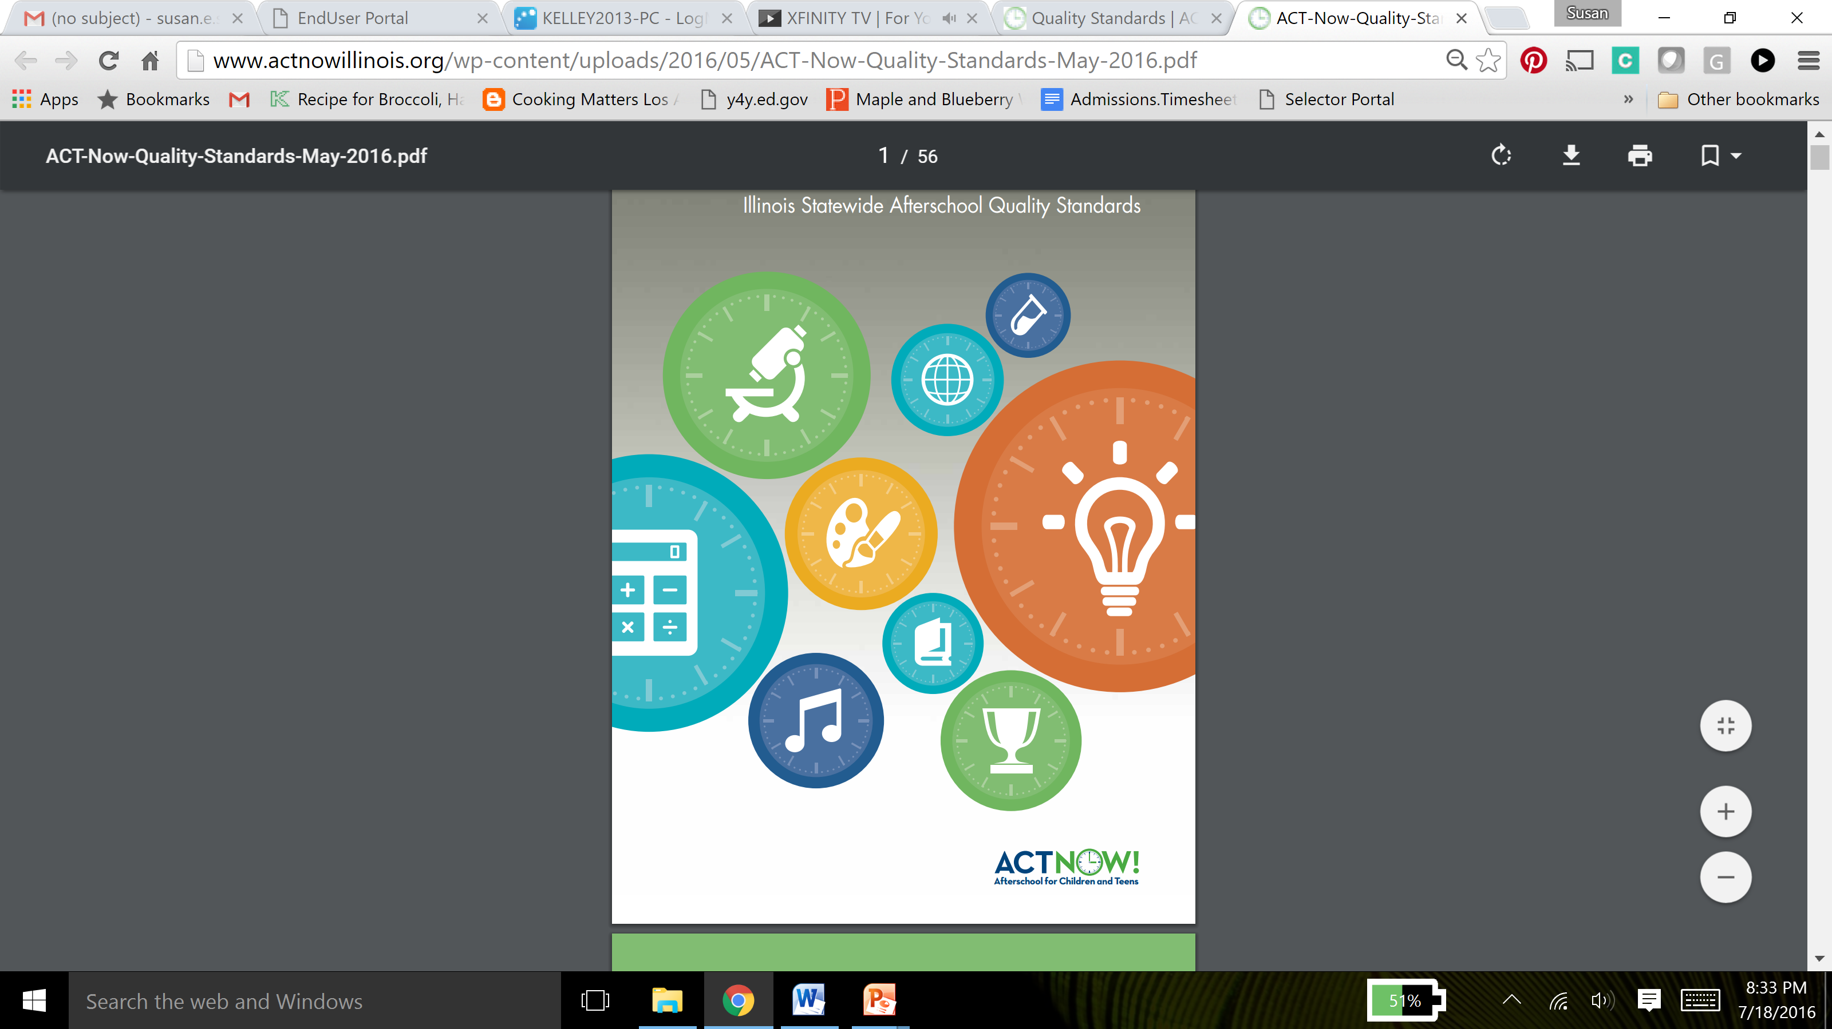
Quality Programming
The Standards capture what has been demonstrated, through research, to lead to positive outcomes for children and were developed through a two year collaborative process involving key stakeholders.
As free, voluntary guidelines written to support programs.
Created with the landscape of the afterschool field in the context of Illinois and the providers’ input in mind.

Slide 13
How the Standards Are Broken Down
Core Areas
Guiding principle that introduces the category
Program Standards
Delineate the important components of each Core Area
Quality Indicators
Specific actions or initiatives programs can take to meet each Quality Standard and ways to measure growth for each Quality Standard
Notes:
Each Core Area is framed with a guiding principle that introduces the category. The Core Areas are then each broken into Program Standards and Quality Indicators which provide specific actions or initiatives programs can take to meet that Quality Standard. While most Standards will apply to all programs, some are specific to particular program settings and service delivery models and may not be as generally applicable.

Slide 14
Standards Core Areas
Indoor and Outdoor Environments
Safety, Health, and Nutrition
Administration
Partnerships with Schools
Professional Development and Qualifications
Family and Community Partnerships
Youth Development, Programming, and Activities

Slide 15
How to Use Quality Standards
Programs
Parents and Families
Funders & Policymakers
K-12 Educators
Higher Education
Notes:
Afterschool Providers: Develop a quality improvement plan, determine areas of strengths and weaknesses, and decide areas of professional development to pursue for staff
Parents and Families: Understand the key elements of a high-quality program and be able to advocate for quality programs for their children and within their own communities
Funders and Policymakers: Link funding to research-based practices that lead to measurable outcomes and evaluate and improve programs
K-12 Educators: Understand the key elements of high-quality programs, provide a common language for partnership, and provide a guide to reinforce and advance key priorities
Higher Education: Assist in designing content for courses related to youth development providers and in choosing strategic partners for research initiatives

Slide 16
Translating the Standards to College Readiness
Many connections, especially in Core Area 5, 6, and 7
Program Standard 22: Staff encourages youth to make thoughtful and responsible decisions
  Leadership role
  Weigh pros and cons
  Exercise their voice
  Influence the content

Slide 17
Translating the Standards to College Readiness
Program Standard 24: The program is intentional about creating a positive afterschool climate that is emotionally and physically safe and that supports and accelerates student academic, social, and emotional learning
  School day learning
  Connect with schools and families about student needs
  Real-life applications
  Tools and resources for families
  Communicate with families
  Engaging learning methods
  Tailor it to students skills and interest
  Inspire and prepare youth for the future
  21st Century skills

Slide 18
Activity
Pair up
Take an indicator from Core Area 6
Come up with two ways to apply to College Readiness
Share out!

Slide 19
Resources

Slide 20
Questions

Slide 21
Contact Information
Susan Stanton, sstanton@voices4kids.org
Shallie Pittman, spittman@voices4kids.org

